Slide 1
Research Challenges and How to Overcome Them
Prof Masud Khan

Slide 2
Research Challenges
Being a researcher is rewarding and challenging - you get to explore new ideas, work with cutting-edge technology, learn about the world, and make contribution with new knowledge
As a postgraduate student, conducting research is an integral part of project and mission that brings many challenges
Each person’s research is different and has a unique response. Having the right attitude and mentality when dealing with these issues always will help the situation

Slide 3
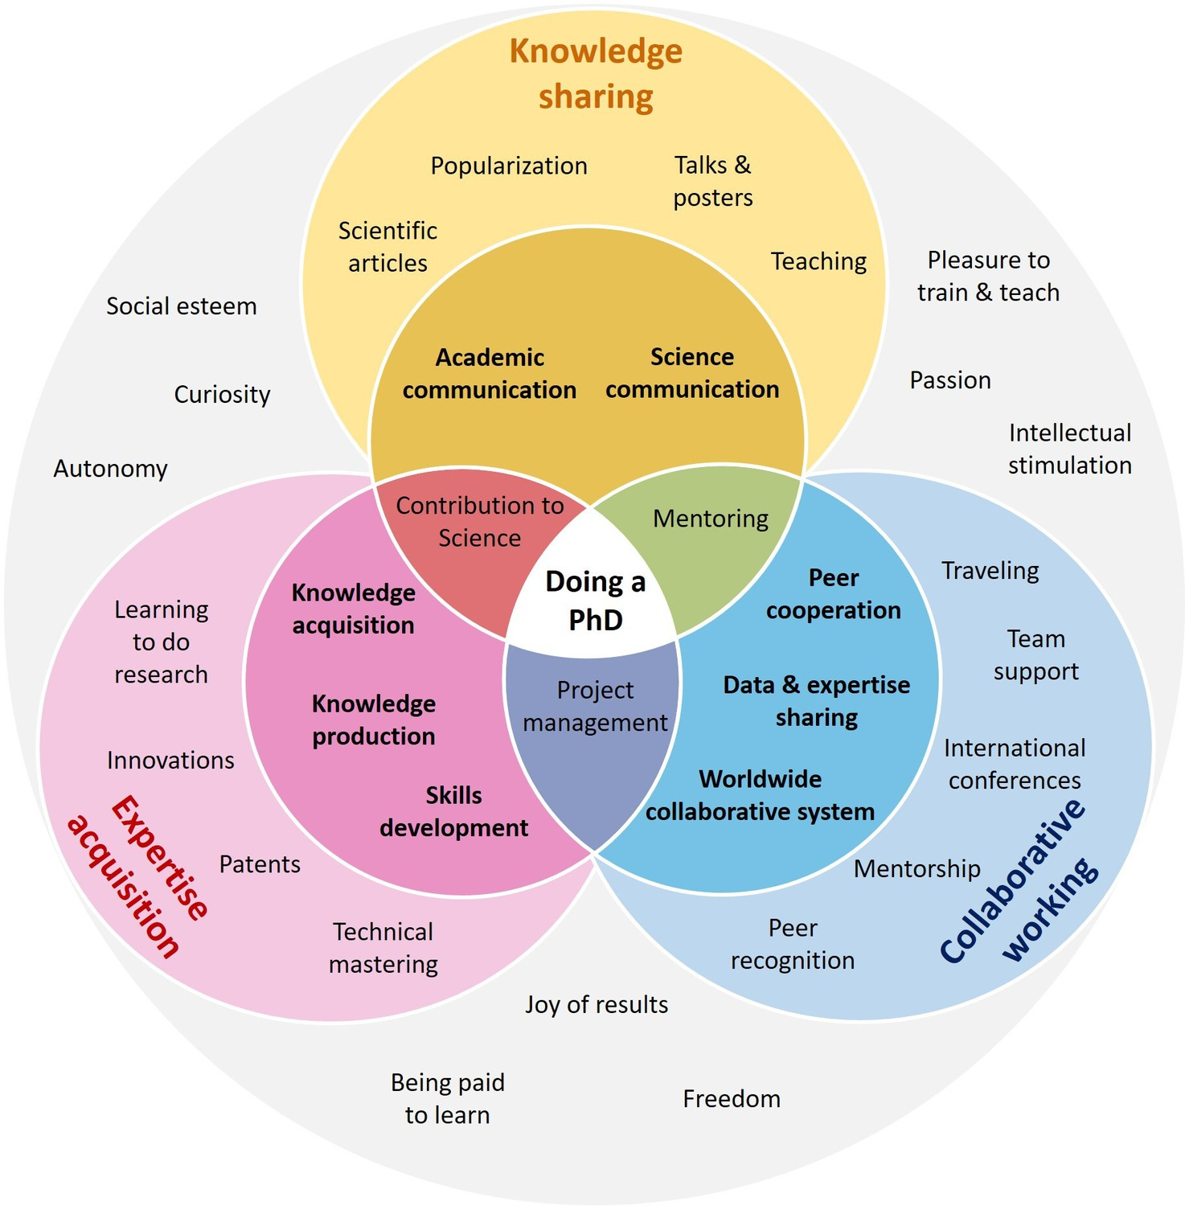
Venn diagram

Slide 4
Research Challenges
Challenge: Choosing the Right Topic
Your research topic is the foundation on which all your other work rests, so choose carefully. Select a doable topic considering available resources, time, money, people
Often start from a broad research project idea, then narrowing your focus to a single topic
A well-thought-out topic must have a clear aim and objective with well-defined scope and literature review and importantly its methodology.
It should have an overarching theoretical context for your results
Look for a niche new knowledge in which you can make a difference

Slide 5
Research Challenges
Consider all the angles
Start by identifying a few gaps in your research niche along with different angles you could take on each adding something new to the body of knowledge that exists.
Evaluate each topic for how realistically you can achieve it considering resources, money, time limit that are available.
Your final research topic most likely be a lot different from the original one. Stay flexible as you discover potential barriers and develop solutions that you can take to overcome them.

Slide 6
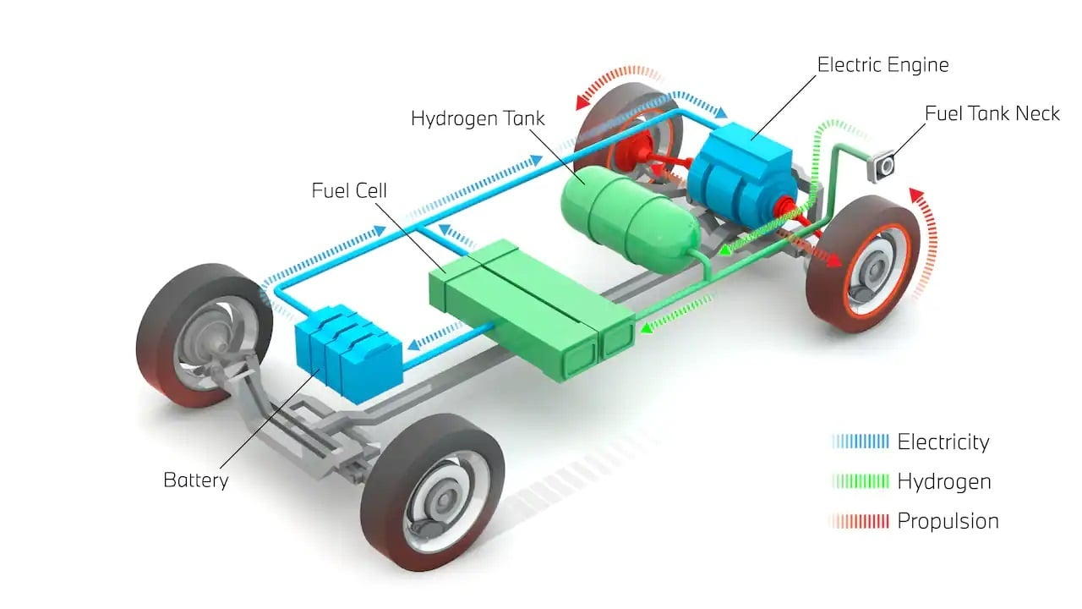
Example: Hydrogen Powered Cars - Fuel cell electric vehicle
https://au.pcmag.com/ccars-auto/94720/hydrogen-powered-cars-fuel-cell-electric-vehicles-explained

Slide 7
Example: Hydrogen Powered Cars - Fuel cell, Hybrid and Electric Vehicle
https://afdc.energy.gov/vehicles/how-do-fuel-cell-electric-cars-work
https://afdc.energy.gov/vehicles/how-do-all-electric-cars-work
https://afdc.energy.gov/vehicles/how-do-hybrid-electric-cars-work
https://afdc.energy.gov/vehicles/how-do-gasoline-cars-work

Slide 8
Example: Hydrogen Powered Cars - Fuel cell electric vehicle
Topics for Investigation:
Production and Conversion
Storage and Transportation
Application and Transition
Need to narrow down to a specific topic for a project

Slide 9
Narrowing down to a specific topic
Production paths - hydrogen from hydrocarbon-based, renewable or carbon-reduced process and or from zero emission (electrolysis).
Hydrogen needs to be compressed/liquified, transported, stored and transferred to the end user.
Whether generated by electrolysis or by reforming- the gaseous or liquid hydrogen needs to undergo market processes before it can be used by the customer.

Slide 10
Narrowing down to a specific topic
Different 'business as usual' scenarios are analysed for a country and the World concerning end energy use in different sectors.
Currently there is a very small penetration of hydrogen indicating - hydrogen economy is a long-term option.
Use of hydrogen competes with the direct use of clean primary energy and/or use of electric energy based on renewable primary energy. Therefore, must have cost advantages in comparison to the use of renewable energy or biomass.
Other project example: Feasibility study of vehicle transport in New Zealand using green hydrogen
Falling of bubble into a bowl – that describes the dynamics, predicts splashing contour and shape etc.
Industry/Manufacturing automation

Slide 11


Research Challenges

Slide 12
Example - Case Study
Develop a research project
Aim and objective
Scope and literature review
Planning step-by-step process (Flow Chart)
Methodology
Identify resources and end goal
Check timeline
Results and analysis
Validation and discussion
Check if the set aim has been achieved

Slide 13
Research Challenges
Challenge: Choosing the Right Methodology
The methodology is driven by the research question, not from your personal preferences for one design or another
If your questions include words such as “explore,” “understand,” and “generate,” it indicates your study is qualitative.
Words such as “compare,” “relate,” or “correlate” indicate a quantitative study. The methodology should be designed accordingly.
For a qualitative study, you need to collect data from simulation, literature, focus groups and interviews etc.
A quantitative study involves experiment, test scores or survey results.
The project should have clear flow chart for any other trained researcher to follow.

Slide 14
Research Challenges
Challenge: Dealing With Your Results/Data
As you complete your study, the final challenge is knowing how to make sense of the results/data you have obtained/collected
Analysis and synthesis of data and test results – do they support/validate the theory
Check if the aim and objective of the project have been met
Ensure that your work add new insight/findings to the body of the existing knowledge.

Slide 15
Research Challenges
Challenge: Staying Self-Motivated and Managing Your Time
Fight to maintain a good balance between other works and personal tasks maintaining deadlines, avoiding procrastination on tasks you do not enjoy
Map your project in a visual calendar- Input deadlines/tasks into a digital or physical calendar to help you break down tasks into more manageable chunks.
Set up a reward system - Think of rewards (nice meal, enjoying favourite show or fund day trip) and tie them to specific project milestones.
Find accountability buddies - Share your research goals with someone you trust and ask them for feedback/comments.

Slide 16
Challenges
Challenge: Supervisor-Student Relationship
Supervising RHD students is about guiding them to satisfactory completion within the approved time meeting academic requirements
The relationship with your supervisor is vital and an opportunity to learn from their experience.
Build a professional relationship, maintain regular communication - face to face, telephone, emails, video
Allow yourself to be mentored by them even though you may hold different views.
Engage in academic and social environment turning technical into inspiring exercise and fun

Slide 17
Research Challenges
Overcoming imposter syndrome
Researchers must expose themselves and their work to criticism and this can lead to feelings of self-doubt and you may feel that you are not as capable as others, you might be experiencing imposter syndrome.
It is a problem that people in all professions face despite all they have accomplished
Remind yourself of your research (and personal) success

Slide 18
Confidence Building
No research is a straight and smooth, it has ups and down
Maintain self-belief and avoid panic
Learn to enjoy
Engage and share your thoughts with cohort
Face challenges knowing that there are solutions that you need to explore and will find
Convincing others the value of your research
Reflect on your research purpose throughout the development and execution of your research. Reflection helps you maintain confidence in your goal

Slide 19
Research Challenges
Building a good research team (or finding collaborators)
Research is best done with research collaborators in the same field of research to connect with.
You will quickly realize that your biggest competitors are often your best potential partners.
Use all available resources and expand your network
If you are new or early in your career, look for mentoring schemes at your institution or apply for funding to attend academic conferences. If you already have a significant network, think about potential collaborators you can reach out to

Slide 20
Research Challenges
Recruiting research participants (or collecting samples)
Managing sample collection is a difficult part of many research projects and is often the biggest hurdle between the question you have and the data you need to answer it
Do not be afraid to ask (but be sure to come prepared)
Use research tools that help you collect data from participants. These tools will not help if you are afraid or unprepared to ask for help.

Slide 21
Research Challenges
Research challenges: Expecting the unexpected
Being a researcher is full of unpredictable challenges. Careful preparation and planning can help with some of the common ones that come up.
Recognize early on that your research is never going to go exactly the way you anticipate
Maintain a curious enthusiasm about your research question and your research process. It will help you think outside of the box when unexpected challenges inevitably arise.
References: (Matthieu Chartier, PhD.Founder @ Fourwaves)

Slide 22

Success and Celebration

Slide 23
Questions

